Slide 1



PROJECT : GARBAGE
CLASSIFICATION

Slide 2

Learning Objectives:
1.Understand Garbage Types: Identify different categories of waste (e.g., plastic, Metal, glass, card board, Trash, Paper)
2.Data Handing: Collect, label, and preprocess garbage image datasets for training.
3.Image Classification Techniques: Use Convolutional Neural Networks(CNNs) or transfer learning (like MobileNet , ResNet) for image-based classification.
GOALS:
1.Environment Awareness: Promote sustainable Waste management through automation.
2.Automation Of Waste Sorting: Reduce human error and improve recycling efficiency by using AI to classify garbage.
3.Real-World Implementation: Enable smart bins or municipal systems to auto-sort waste, reducing costs and improving hygiene.
GOAL
Source :
www.freepik.com/

Slide 3
Tools and Technology used:
Tool/Technology: Purpose:
Python - Core programming language.
Jupyter Notebook - IDE for development and testing.
TensorFlow / Keras - Machine learning and deep learning.
OpenCV - Image processing.
Matplotlib / Seaborn - Data visualization.
Numpy / pandas - Data handing and manipulation.
Google Colab(Optional) - Free Cloud Training.

Slide 4
Methodology:
1.Dataset Collection: -Use Kaggle dataset (e.g., Garbage Classification Dataset).
-Contains images labeled as organic, recyclable, hazardous, etc.
2.Preprocessing: -Resize all images to 128*128.
-Normalize pixel values.
-Split data into training (80%) and testing (20%).
3.Model Evaluation: -Accuracy: ~90% on test set.
-Visualized loss/accuracy graph.
-Confusion matrix for class-wise performance.
4.Output Interface: -Web interface using Streamlit (if deployed).
-Upload image ~ Get prediction.

Slide 5
Problem Statement:
Manual Waste segregation is time-consuming and error-prone. Improper disposal of waste causes environmental and health issues. These is a need for an intelligent system that can
“automatically classify garbage images” into different categories to support effective waste management and recycling.

Slide 6
Solution:
Develop a machine learning model (preferably using Convolutional Neural Networks – CMM) that can automatically classify garbage images into the following classes:
- Organic Waste (e.g., food, leaves).
- Recyclable Waste (e.g., plastic bottles, cans).
- Hazardous Waste (e.g., batteries, medical waste).
- General Waste (e.g., non-recyclable, non-hazardous).

Slide 7
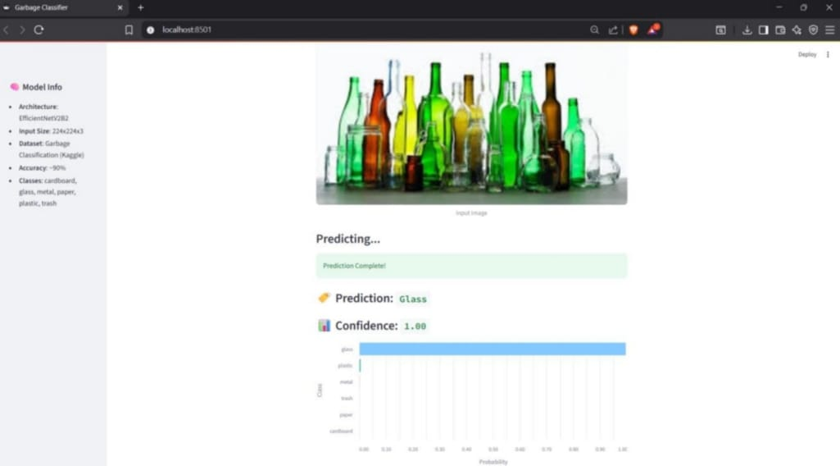
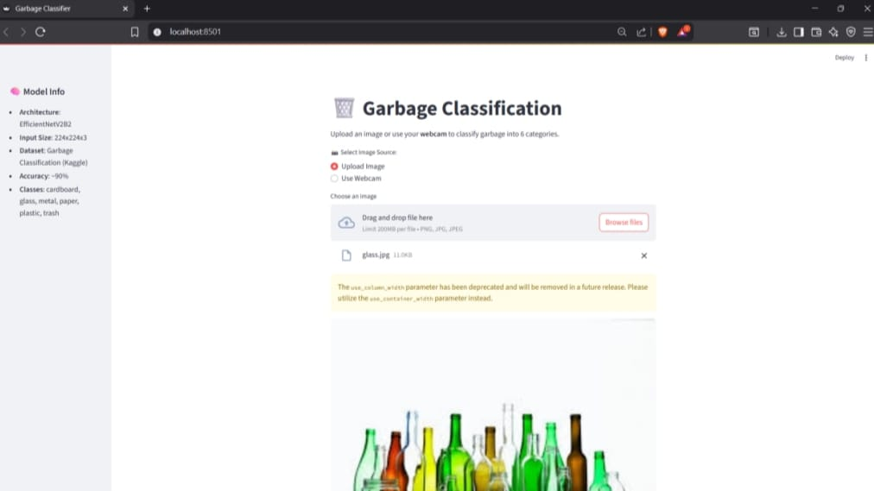
Screenshot of Output:

Slide 8
Conclusion:
This project demonstrates how AI can play a significant role in environmental protection by helping to automate waste segregation. Using image classification techniques like transfer learning with EfficientNetV2B2 and deep learning models, the system achieves high accuracy in classifying different types garbage.
It can be implemented in real-world applications like smart dustbins or sorting lines in recycling plants.

